Slide 1
ReCreative AI : Dynamic Text Analysis Platform

Slide 2
Contents
01
Objectives
02
Architecture
03
Features
04
Framework
05
Challanges
06
Future Scope

Slide 3
Objectives
The goal is to develop a dynamic text analysis platform that can accept various types of text data, extract key themes and topics, and summarize them into actionable insights and recommendations. ReCreative AI is designed to efficiently process diverse inputs—whether they’re text, articles, reports, or social media content—by identifying key themes and summarizing the information into concise, easy-to-understand visual outputs.
3

Slide 4
Architecture

Slide 5
Data Pipeline
Anyone can use this platform
Give any type of Input
Identify the input file type
Classify in different topic
Generate small summary
Give the output to user
User
UI
Input
API
File
Extract
Cleaning
Topic Modelling
Sentiment
Analysis
Summary
Insights
Output
Visualisation
Interactive, user friendly UI
Smoothly process input to the backend
Preprocess the data
Identify topic wise sentiment
Generate Insights and recommendations
Visual through UI

Slide 6
Features
User friendly smooth, interactive UI
Auto-optimized topic discovery
Hybrid summarization pipeline
Context aware 3 class sentiment
Topic-sentiment fusion
Strategic insight generation
High-end visual output

Slide 7
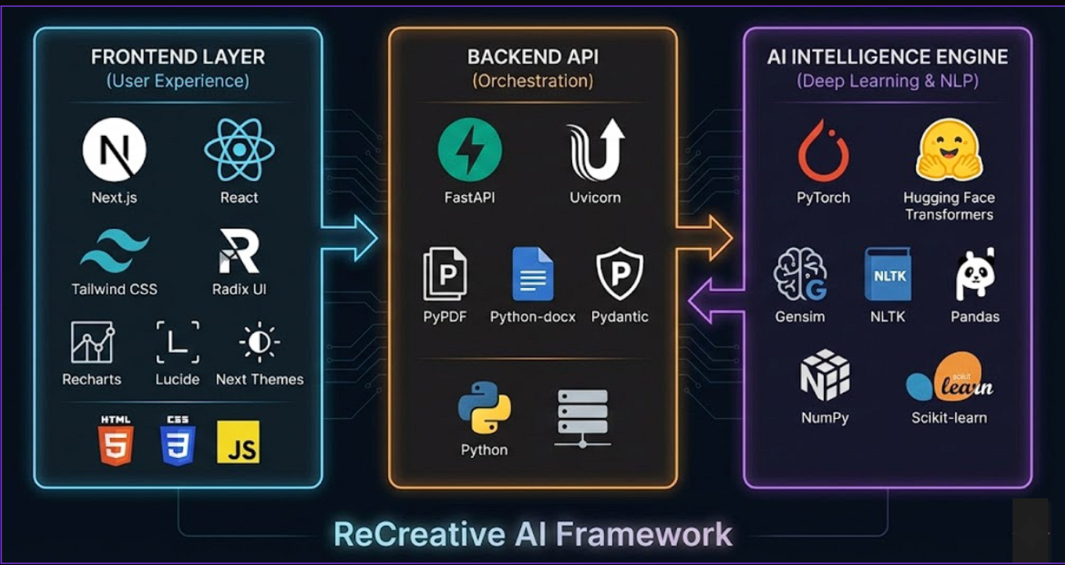
Framework

Slide 8
Challanges
High level
Reducing the long processing latency when analyzing massive datasets to ensure a responsive user experience.
1
Medium level
Optimizing resource-heavy AI models to execute efficiently on limited hardware resources.
2
Lower level
Preventing system crashes by robustly handling unexpected errors and malformed file inputs
3

Slide 9
Future Scopes
Scalable Performance Optimization
Implement distributed computing to drastically speed up analysis for massive files.
Enhanced Model Accuracy
Fine-tune core models on domain-specific data to maximize precision in sentiment and topic detection.
Generative Q&A Assistant (RAG)
Add a chatbot that lets users ask questions directly to their documents.

Slide 10
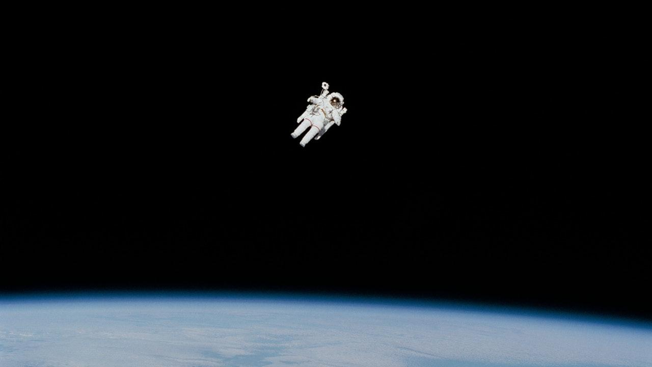


Thank You

